Slide 1

EEA Enlargement
Ukraine Technical Exchange Visit to EEA
EEA Governance Unit –
Galina Georgieva, Nikolaj Bock, Milan Chrenko
23 October 2025, Copenhagen

Slide 2
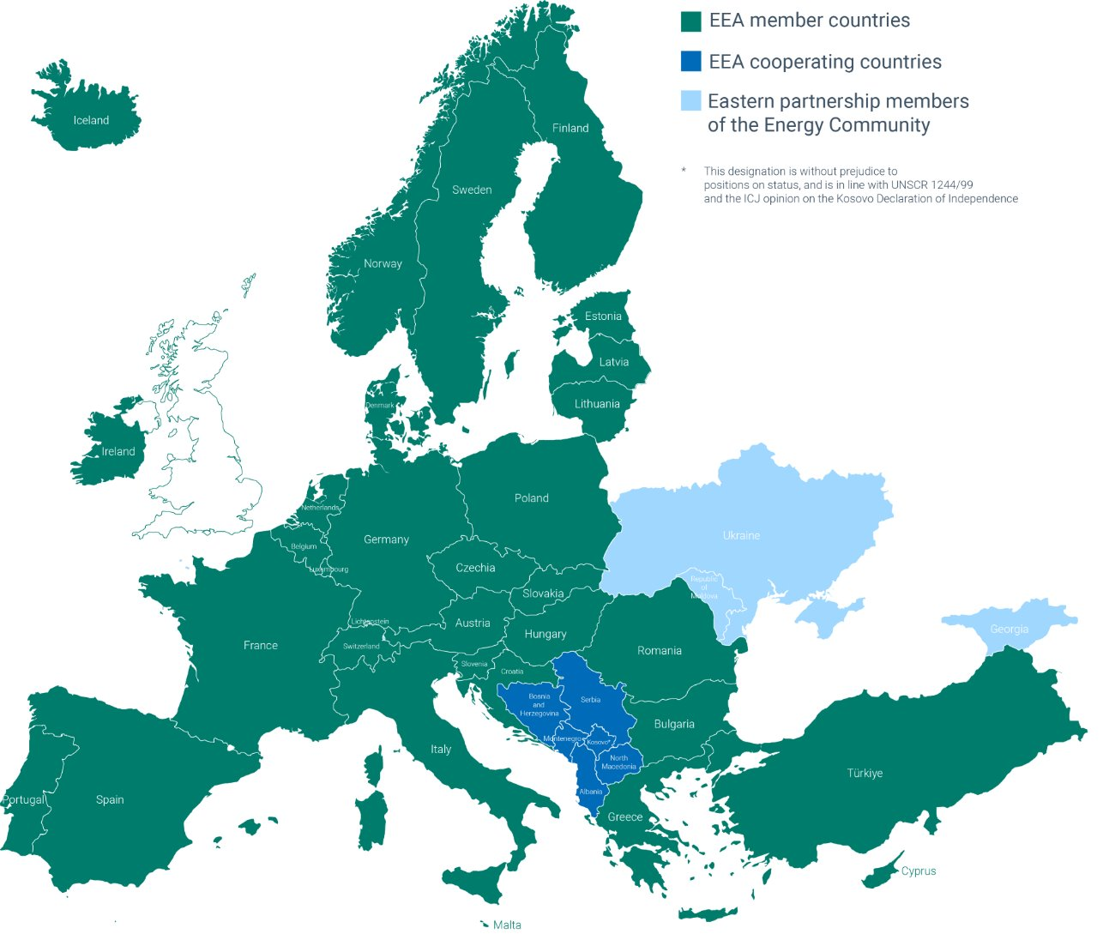
EEA-Eionet – beyond EU
EEA and Eionet Founding Regulation envisages the possibility of membership to non-EU countries with similar environmental objectives under specific agreements concluded between them and the EU.
Third country membership is only possible for very few EU decentralised agencies.
Currently five non-EU members of the EEA and Eionet: Iceland, Norway, Liechtenstein, Switzerland and Türkiye.
Notes:
You have already heard about the Eionet coverage and EEA cooperation with the Western Balkans.
On the map you also see the current cooperation activities with Ukraine + Moldova & Georgia under the Energy Community project, implemented by EEA

Slide 3
Cooperation status vs Membership
Cooperating countries (Western Balkans)
Member countries (EU, EFTA)
Voluntary, no legal basis
Focus on technical cooperation and capacity building in preparation for full membership
Participation in identified Eionet activities
Observer in EEA Management Board (on rotation)
External/non-core funding (through ear-marked financial instruments)
In some cases, signature of MoUs to support the continuity of engagement
Formal status (legal basis Art. 19 of the EEA/Eionet Regulation)
All aspects and areas of EEA work covered
Full incorporation into Eionet structures, including Topic Centres
Full members of the EEA Management Board; without voting rights for non-EU countries
All activities covered by EEA’s annual EU subvention/core-funding
EEA Enlargement
23 October 2025
Notes:
A short overview of the cooperation status (the example of the Western Balkan partners) versus EEA membership (covering 32 member countries in total)

Slide 4
Process for becoming an EEA/Eionet cooperating country
The interested country sends a formal request to the European Commission asking to become a cooperating country
The EEA Management Board agreement to grant cooperating status to the country seeking to join EEA and Eionet
Discussions between EEA and EC leading to the allocation of the resources needed to support the onboarding of the country to EEA and Eionet
Approval of the EEA budget/additional funding by EEA Management Board for cooperation with the country
Signature of agreement between EEA and the country in question

Slide 5
Process towards full EEA/Eionet membership
01. EC initiates the process and recommends to the Council to authorize negotiations with the third country
02. Council reviews the request and decides to authorise the negotiations
→ The procedure is similar to concluding international agreements and could take 3-4 years, depending on various factors.
03. The negotiations are carried out by the European Commission
04. Based on EC proposal after successful negotiations, the Council decides on the agreement’s signature
05. Following the European Parliament’s approval, the agreement is formally concluded
EEA Enlargement
23 October 2025
Notes:
Formal steps outlining the process for joining EEA and Eionet – through the main decision-makers in Brussels.

Slide 6
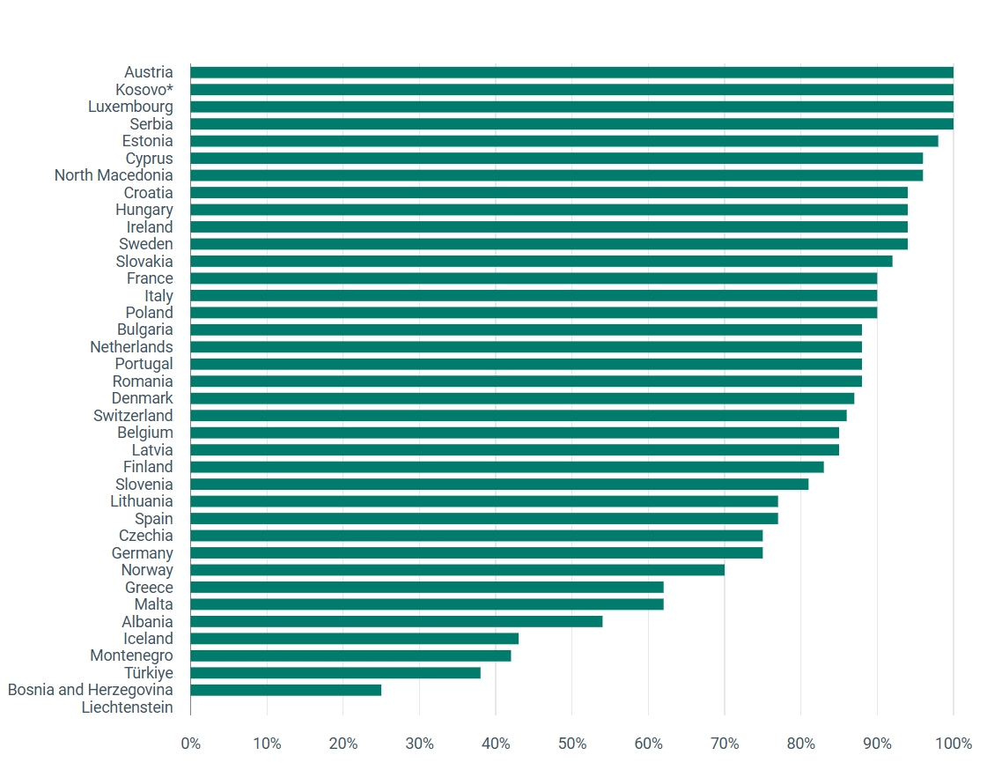

Eionet core data flows
Eionet core data flows reporting performance of countries in 2024
Annual evaluation of deliveries under the Eionet core data flows, published by the EEA since 2005.
The scoring of countries’ reporting performance based on key data flows is considered an important driver, contributing to improved reporting.
Three WB cooperating countries in Top 10 (2024 scoring) with two of them - Kosovo* and Serbia - having achieved a data flow score of 100%!
EEA Enlargement
23 October 2025
Notes:
The provision of high-quality data by Eionet is fundamental for the EEA to achieve its mission to provide timely, targeted, relevant and reliable information to policy-making agents and the public.
The graph presents the results of data collected in 2023 for 12 Eionet core data flows. It summarises the evaluation of hundreds of data deliveries received from reporting countries (on voluntary basis), in many cases used by the countries to report to various commitments in environmental domain.
This overview is produced on annual basis for the part 20 years and is one of the most popular reference, showing progress against agreed reporting criteria (timeliness and data quality) and allowing countries to identify and prioritise the resources they need for regular reporting procedures.

Slide 7

Financial aspects of EEA membership
Full membership of non-EU countries requires payment of an annual financial contribution to the EEA revenue.
No fees to be paid to become a cooperating country.
When candidate countries become EU Member States following the accession process, they automatically become EEA full members, and their contribution is directly covered by the EU subvention to the EEA, paid by the EU Budget.
EEA Enlargement
23 October 2025
Notes:
The five non-EU member countries have three different legal bases and setups for financial participation:
The European Economic Area countries pay a block grant for participation (Iceland, Norway and Lichtenstein).
Switzerland’s contribution is calculated based on the EU contribution divided by the number of Member States (i.e. 1/27th).
Türkiye’s contribution is a fixed amount, calculated based on GDP at the time of joining EEA (2003).

Slide 8
MB agreed with the principle to grant cooperating status to Ukraine and Moldova conditional to additional financial resources to the EEA. A stepwise approach will be needed, starting with a Decision to grant a status of cooperating country to Moldova (that already has sent a formal request). Given the fact that the official request by Ukraine is still pending, the MB Decision concerning Ukraine will be a second step.
Extract from the final Decision List of 104th Management Board meeting, held on 20 March 2025
Notes:
Earlier this year, the EEA Management Board discussed the EEA enlargement and agreed to proceed with granting cooperating status to Moldova and Ukraine, conditional to additional resources allocated to the Agency.
The process with Republic of Moldova is going ahead, with expected date of joining EEA on 1 January 2026.

Slide 9
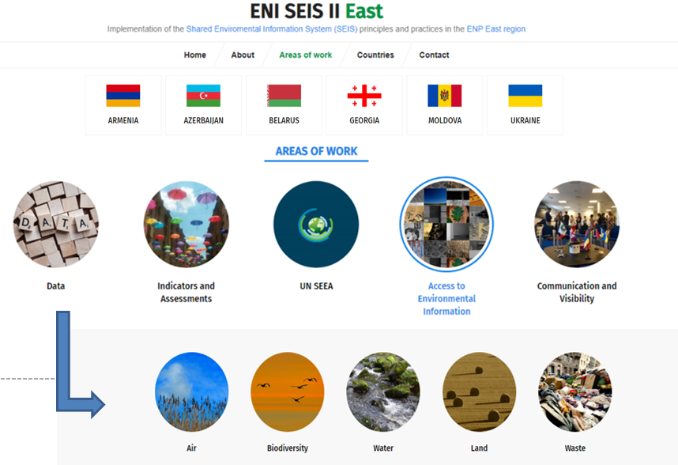
Earlier EEA cooperation activities between EEA and Ukraine
EU-funded cooperation with the Eastern Partnership region in the period 2010-2020
Supporting strengthening of environmental governance in several areas of work, covering environmental & statistical authorities
Close partnership with UNECE & UNEP-Europe
Sustainability of the project outcomes – continue to be relevant for current actions
EEA Enlargement
23 October 2025
Notes:
Beyond the Energy Community activities that you are currently involved in, the Agency has a long-history of engaging with the Eastern partners in the context of the pan-European assessments since Kyiv report (2003).
In the period 2010-2020, the EEA has implemented several big regional projects supporting the implementation of the Shared Environmental Information System (SEIS) principles and practices, designed around Eionet activities. The cooperation under SEIS heading covered a wide range of activities aiming to further improve environmental governance and to support the institutional capacities in the six EaP partner countries in terms of data collection, indicators and assessments. The thematic focus was on air, water and biodiversity data and information, while interested partner countries – including Ukraine – piloted other areas such as land and waste. The project addressed ways to increase accessibility and the use of environmental data and information, to improve the effective sharing of the data and information across the region and to reduce the reporting burden. Project activities – closed in 2020 for EEA, but still continuing under other EU-funded umbrellas – allowed the various networks and experts in the partner countries to actively engage in identified activities and strengthened the communication and dialogue on environmental issues.

Slide 10

Thank you!
In case of further questions, please address the EEA Governance Unit or <Galina.Georgieva@eea.europa.eu>
Notes:
Thank you for your attention! In case of any further questions, please reach out to the EEA Governance Unit

